Slide 1


A Scalable, Commodity Data Center Network Architecture
Presented By:
Mahek Desai
Apoorva Rumale
Department Of Computer Science
California State University, Northridge

Slide 2
A Scalable, Commodity Data Center Network Architecture
Authors:
Mohammad Al-Fares
Alexander Loukissas
Amin Vahdat
Presented At:
Special Interest Group on Data Communication, 2008

Slide 3
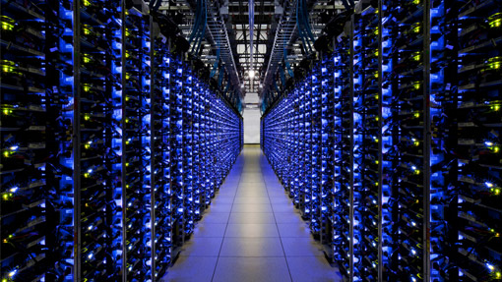
TABLE OF CONTENT
INTRODUCTION
LIMITATIONS OF CURRENT DATA CENTER NETWORK TOPOLOGY
SOLUTION
EVALUATION
STRENGTHS & WEAKNESSES
SUMMARY

Slide 4

INTRODUCTION
Increasing popularity of thousand-node clusters.
The retrieval of a single web page can require coordination and communication with literally hundreds of individual sub-services running on remote nodes.
Ethernet switches and routers are used to interconnect cluster machines.
Unfortunately, aggregate cluster bandwidth scales poorly with cluster size, and is expensive.

Slide 5

WHAT IS A DATA CENTER?
It is a facility that centralizes an organization’s IT operations and equipment for the purposes of storing, processing and disseminating data and applications.
For example, Amazon Web Services.

Slide 6

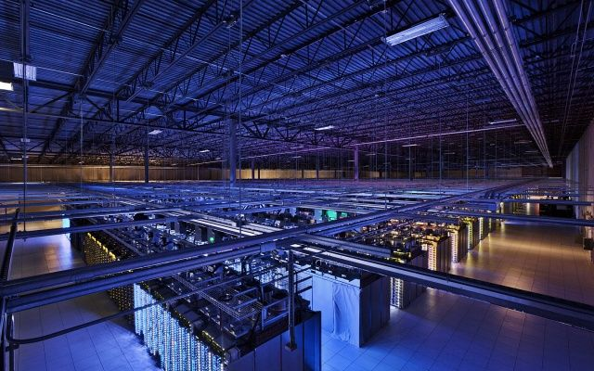
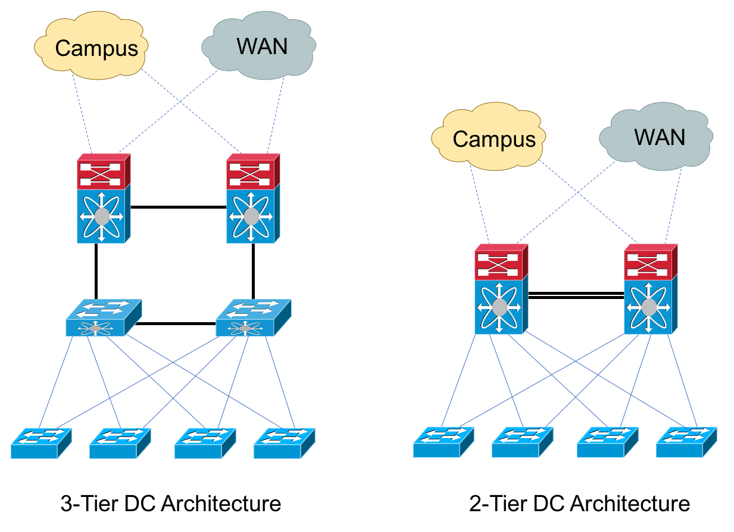
CURRENT DATA CENTER NETWORK TOPOLOGY
Core Layer
Aggregation Layer
Core Layer
Edge Layer
Edge Layer

Slide 7

OVERSUBSCRIPTION
LIMITATIONS OF CURRENT DATA CENTER NETWORK TOPOLOGY
It is the practice of committing more network bandwidth to devices connected to that network than what is physically available.
For example, your typical Internet Service Provider.
The ratio of network's potential demand to its contracted rate is Oversubscription Ratio.

Slide 8
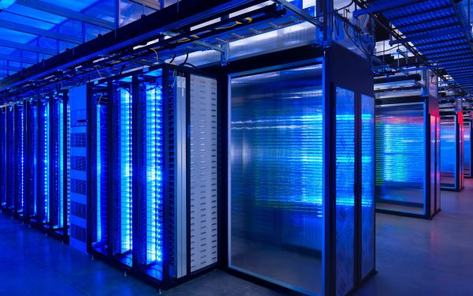
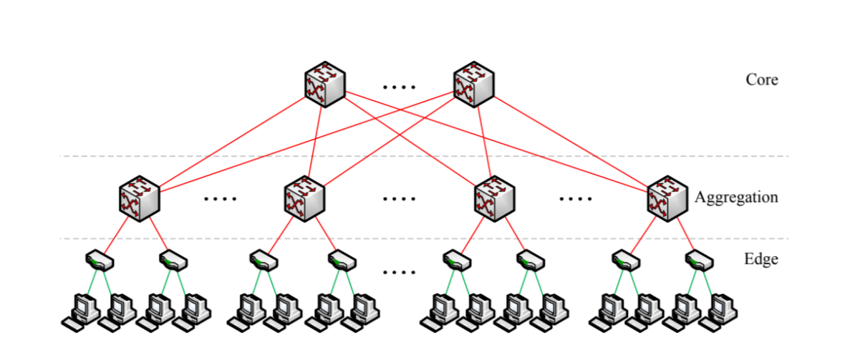
EQUAL COST MULTI PATH ROUTING (ECMP)
It is a network routing strategy that enables packets of traffic from the same destination or source IP to transmit across multiple best path with equal cost.

Slide 9
EQUAL COST MULTI PATH ROUTING (ECMP)
Load Balance: Load Balancing equally distributes network traffic or load across different channels.
Load Split: Load Splitting includes sending a portion of the traffic to one server and the rest to another.

Slide 10

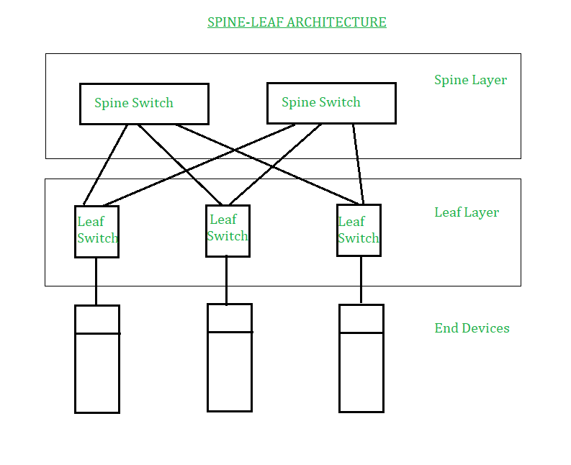
CLOS NETWORK

Slide 11
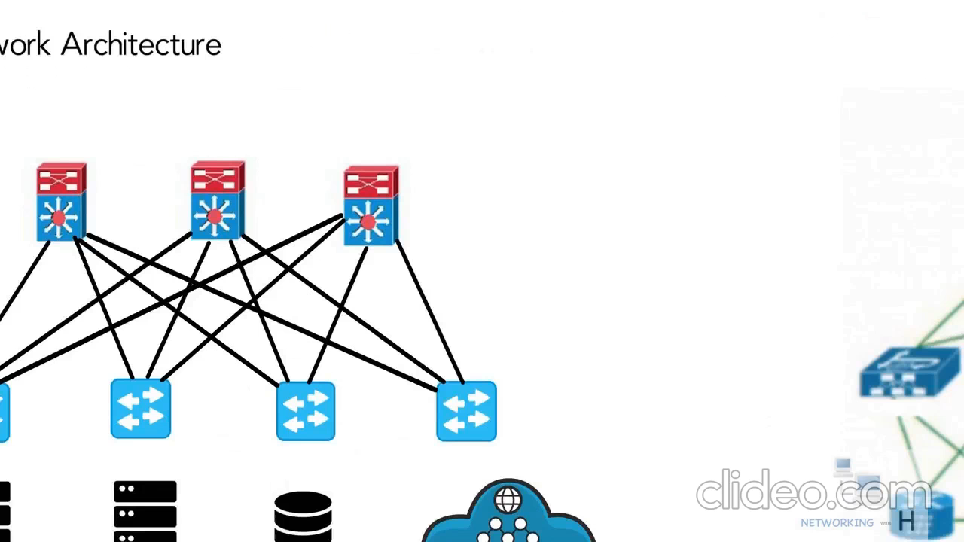

Slide 12
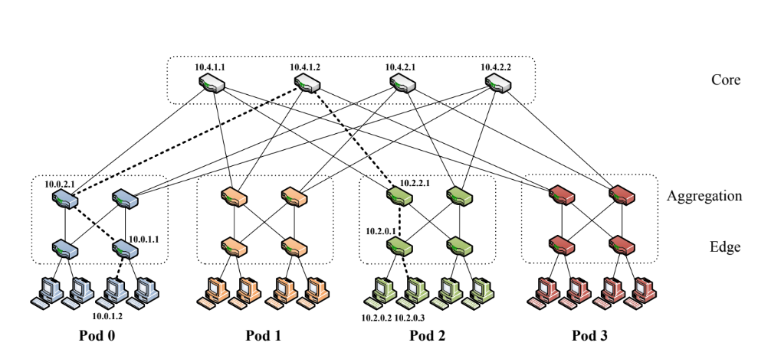
FAT TREE

Slide 13
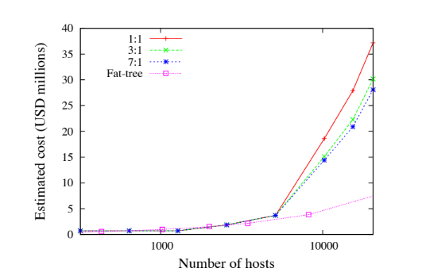
FAT TREE Cont.

Slide 14
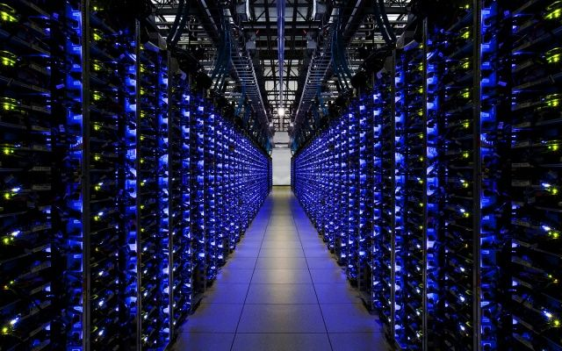
OPEN SHORTEST PATH FIRST (OSPF)
Achieving maximum bisection bandwidth in this network requires spreading outgoing traffic from any given pod as evenly as possible among the core switches.

Slide 15
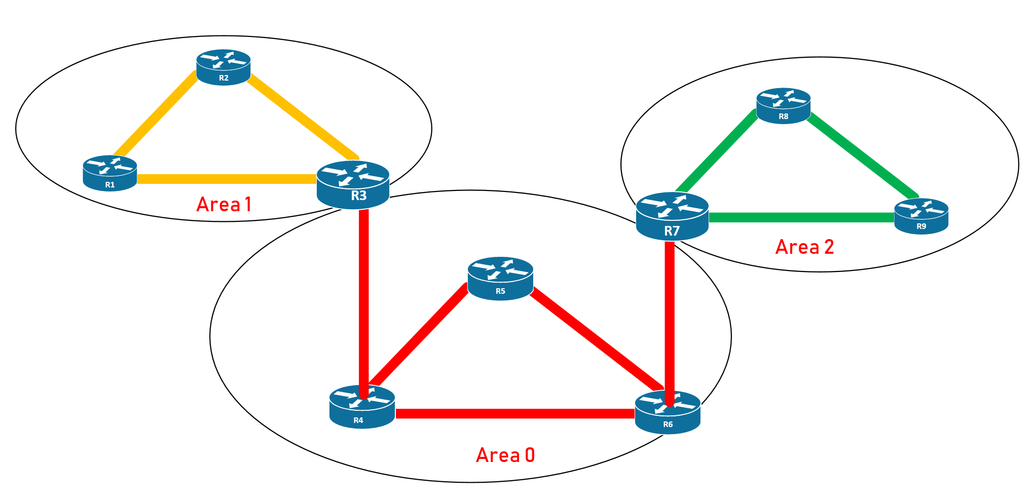
OPEN SHORTEST PATH FIRST (OSPF) Cont.

Slide 16
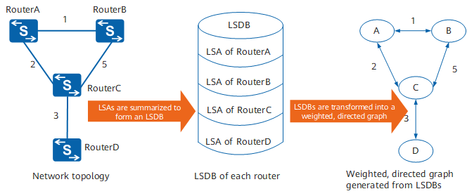
Link State Advertisements (LSA) & Link State DataBase (LSDB)

Slide 17
CONTENT- ADDRESSABLE MEMORY (CAM)
It is a special type of computer memory used in very high speed searching applications.
Search happens in a single cycle.
Content is searched in a parallel way.
Ternary Content- Addressable Memory (TCAM) is a type of CAM.
The term "ternary" refers to the memory's ability to store and query data using 3 different inputs : 0, 1, X.

Slide 18
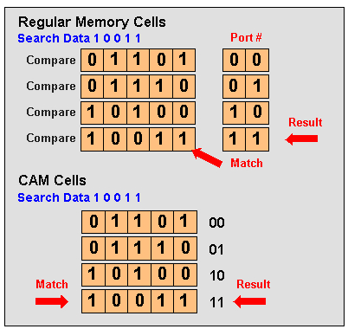
CONTENT- ADDRESSABLE MEMORY (CAM) Cont.

Slide 19
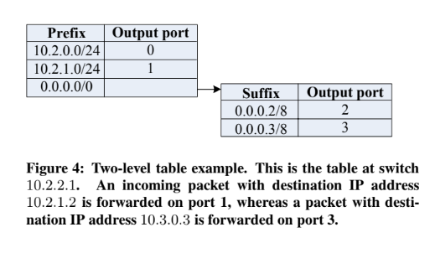
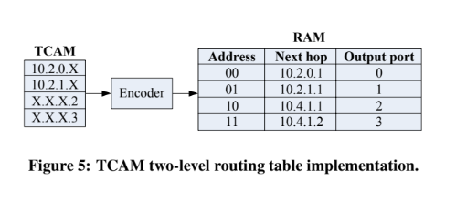
Ternary Content- Addressable Memory (TCAM)

Slide 20

FLOW CLASSIFICATION & SCHEDULING

Slide 21
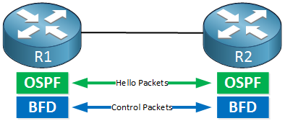
FAULT TOLERENCE
In this scheme, each switch in the network maintains a Bidirectional Forwarding Detection session with each of its neighbors to determine when a link or neighboring switch fails.
BFD is a network protocol that is used to detect faults between two routers or switches connected by a link.

Slide 22

EVALUATION
Experiment was conducted on a 4-ary fat tree with an oversubscription ratio of 3.6:1.
All switches and hosts were connected with a 1 Gigabit Ethernet links.
All virtual links between the click elements in the network are bandwidth limited to 96 Mbits/sec to ensure that configuration is not CPU limited.

Slide 23
SIMULATION ENVIRONMENT
Processor | Dual Core Intel Xenon CPU @ 2.33 GHz
Cache | 4096KB
RAM | 4GB
Operating System | Debian GNU/Linux

Slide 24
BENCHMARKS
Name | Description
Random | A host sends to any another host in the network with uniform probability.
Inter-pod Incoming | Multiple pods send to different hosts in the same pod, and all happen to choose the same core switch.

Slide 25
BENCHMARKS
Name | Description
Staggered Prob (SubnetP, PodP) | Where a host will send to another host in its subnet with probability SubnetP, and to its pod with probability PodP, and to anyone else with probability 1 − SubnetP − PodP.
Stride(i) | A host with index x will send to the host with index (x + i) mod 16.

Slide 26
BENCHMARKS
Name | Description
Same-ID Outgoing | Hosts in the same subnet send to different hosts elsewhere in the network such that the destination hosts have the same host ID byte.

Slide 27
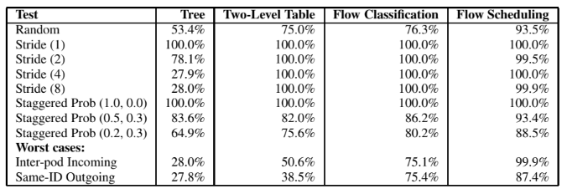
RESULTS

Slide 28
STRENGTH & WEAKNESS
STRENGTH
Deliver scalable bandwidth at significantly lower cost than existing techniques while remaining backward compatible with Ethernet, IP, and TCP.
WEAKNESSES
One drawback of the fat-tree topology for cluster interconnects is the number of cables needed to interconnect all the machines.
Vulnerable to data duplication.
No mention of cost of moving data on network for distributed data.
Evolution of data may be difficult and expensive.

Slide 29
SUMMARY
This paper present a data center communication architecture that leverages commodity Ethernet switches to deliver scalable bandwidth for large-scale clusters.
The authors base their topology around the fat-tree, used OSPF for routing, took TCAM into consideration for memory and implemented BFD for fault tolerance.
They related our work with a system having three-tier topology and using ECMP routing protocol and got the following results.
Total power consumption decreased by 71.43% and total heat dissipation decreased by 66.66% using the proposed system as compared to the related work.
Edge Layer

Slide 30
THANK YOU

Slide 31
ANY QUESTIONS?

